Slide 1
Cyber Security And Me
‘ OR SELECT CyberSecurity FROM Me;
Graduate cyber-security consultant at Capgemini

Slide 2
Who Am I?
A Student
Make problems and solve them
Strong in Python, Java, C# and vb.NET
Play games
Graphic Design

Slide 3
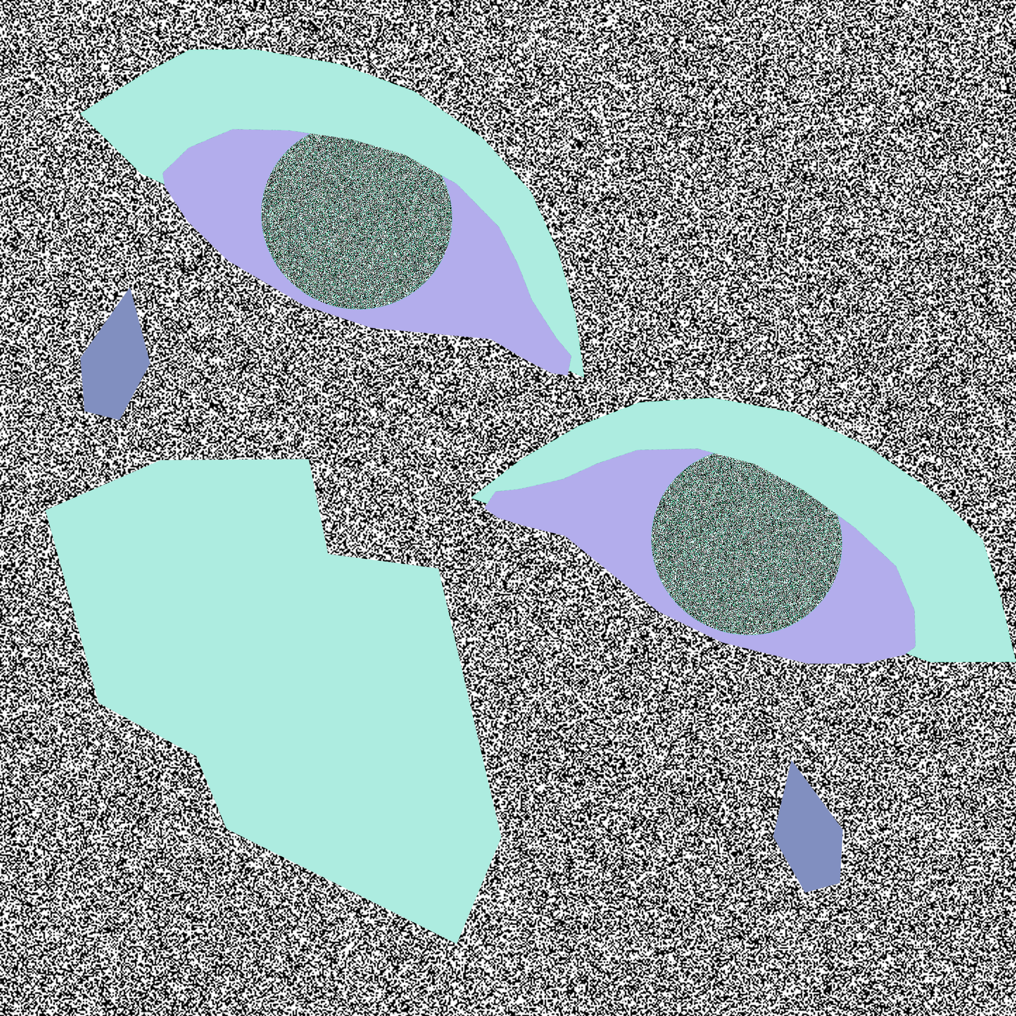

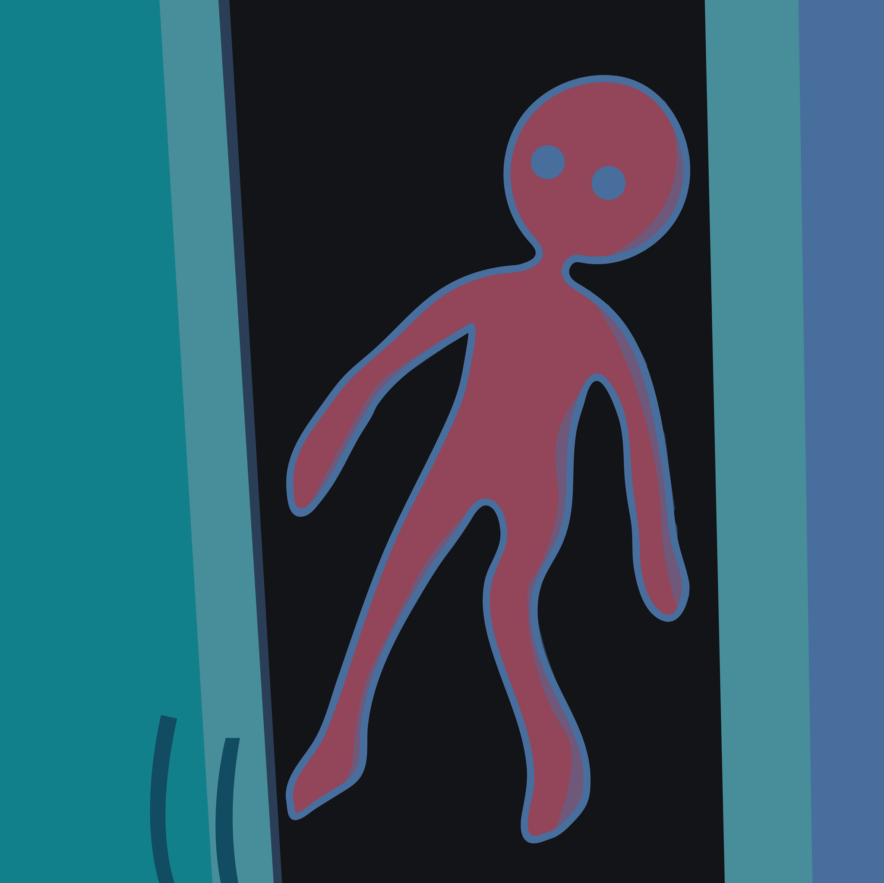

Slide 4
Who Am I?
A Student
Make problems and solve them
Strong in Python, Java, C# and vb.NET
Play games
Graphic Design
Cyber Security

Slide 5
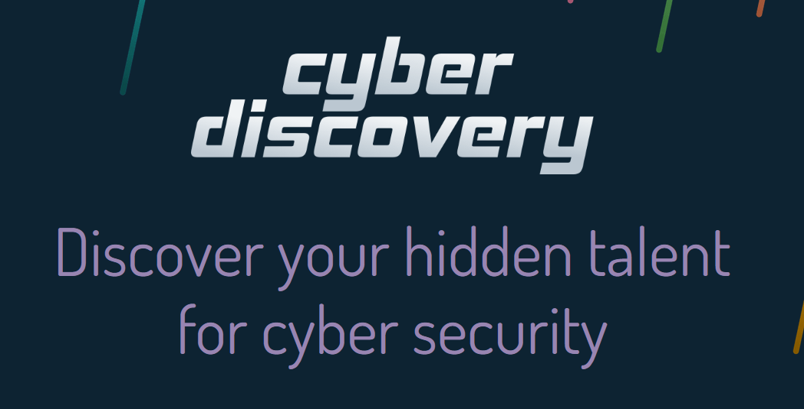
Source: https://joincyberdiscovery.com/

Slide 6
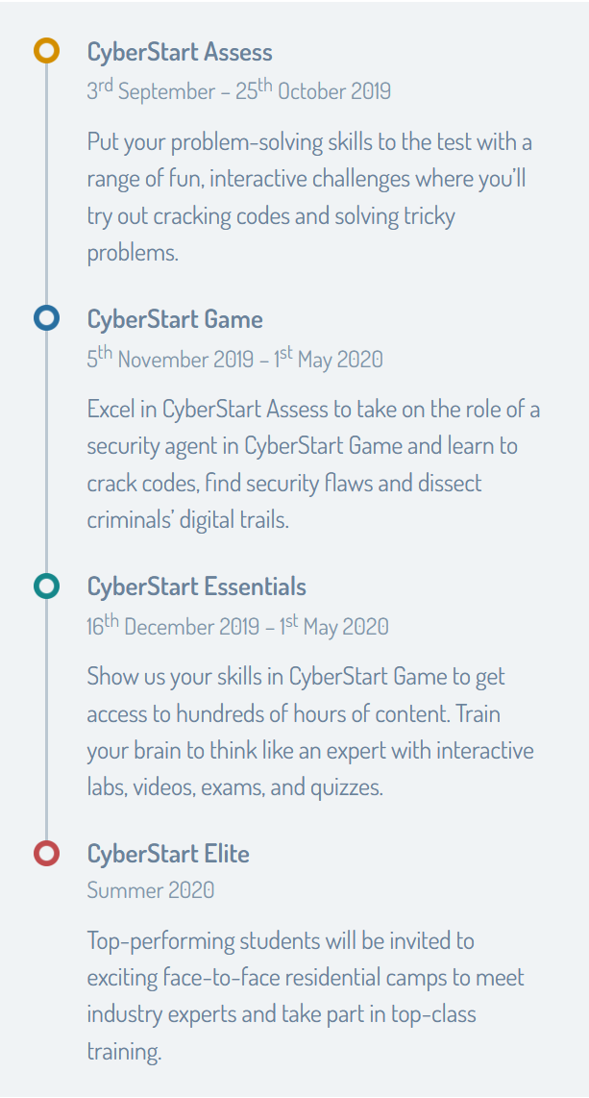
Source: https://joincyberdiscovery.com/

Slide 7
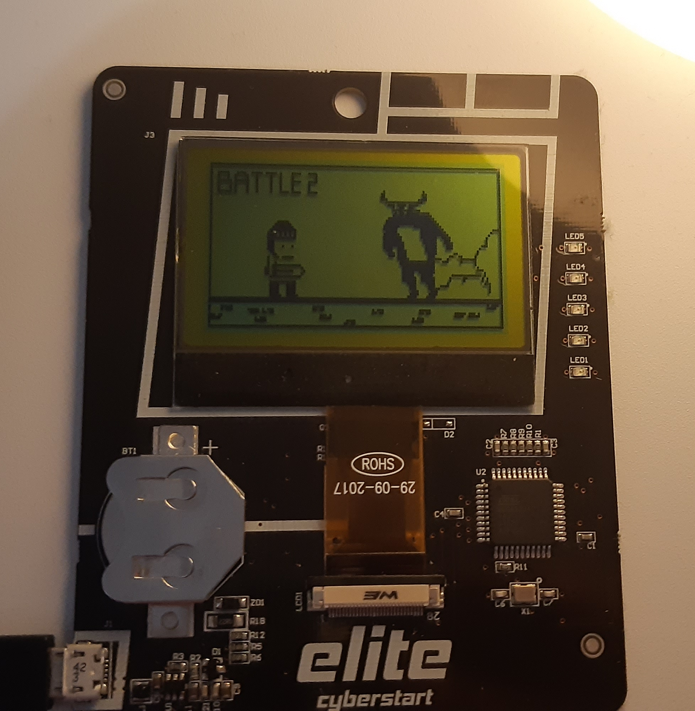
The CTF Challenge
Given an encrypted file
Find a “flag” somehow within it
Submit it online
Hope to win the prize

Slide 8
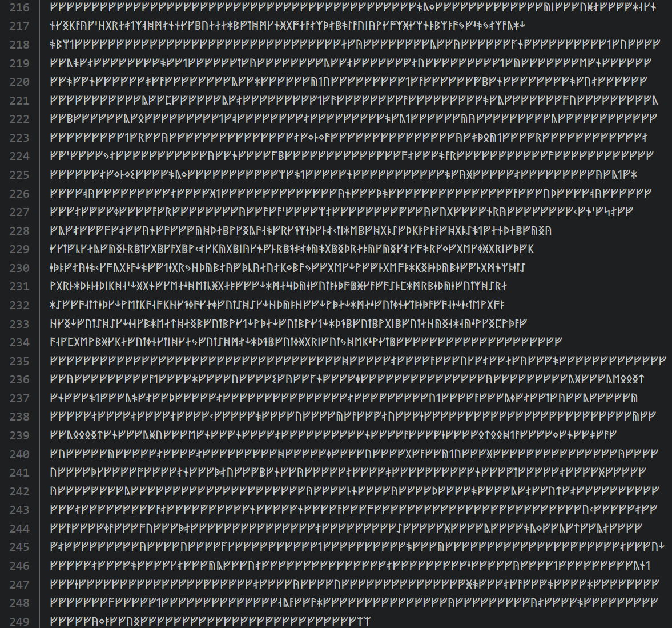
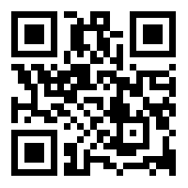

Slide 9
How I solved it
Figure out how to decipher text
Frequency analysis
Sorting character by value
Replace each character with the deciphered version
Save to a file
Go from there

Slide 10
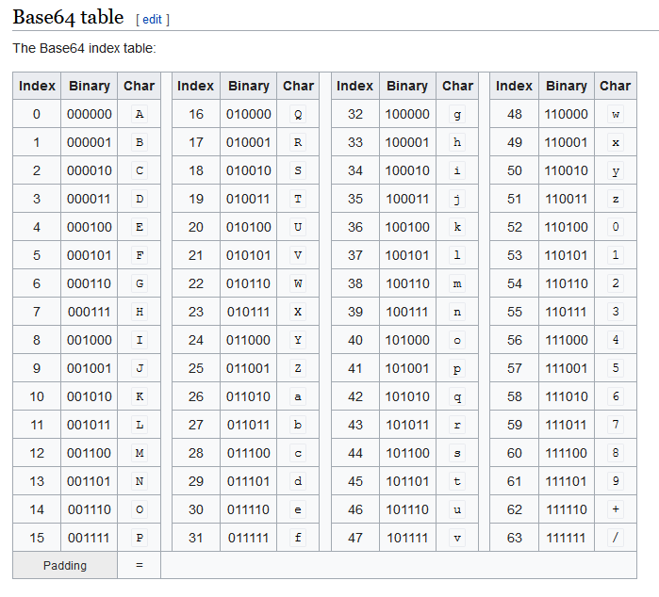
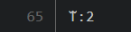
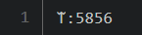
Character Count:
Unicode Value:
Source:
https://en.wikipedia.org/wiki/Base64

Slide 11
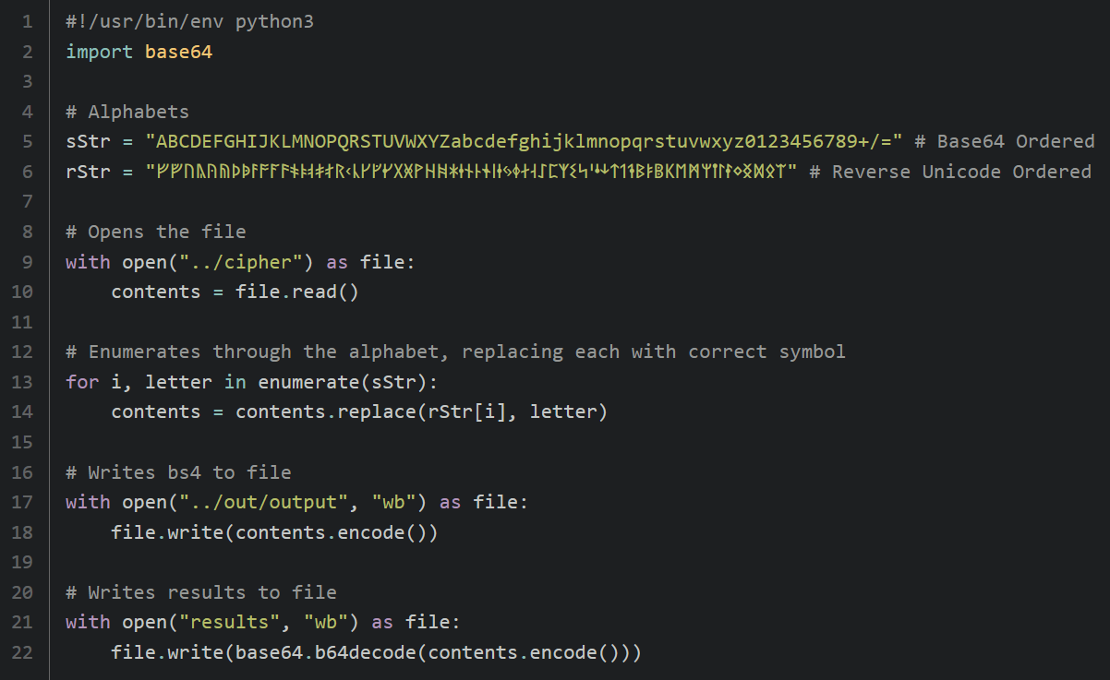
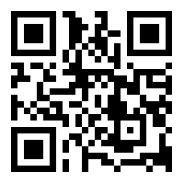

Slide 12
How I solved it
Install 32-Bit Ubuntu Distro
Install Pwndbg : A Assembly Debugger
Make results executable
Try and disassemble and debug to find the flag step by step.

Slide 13
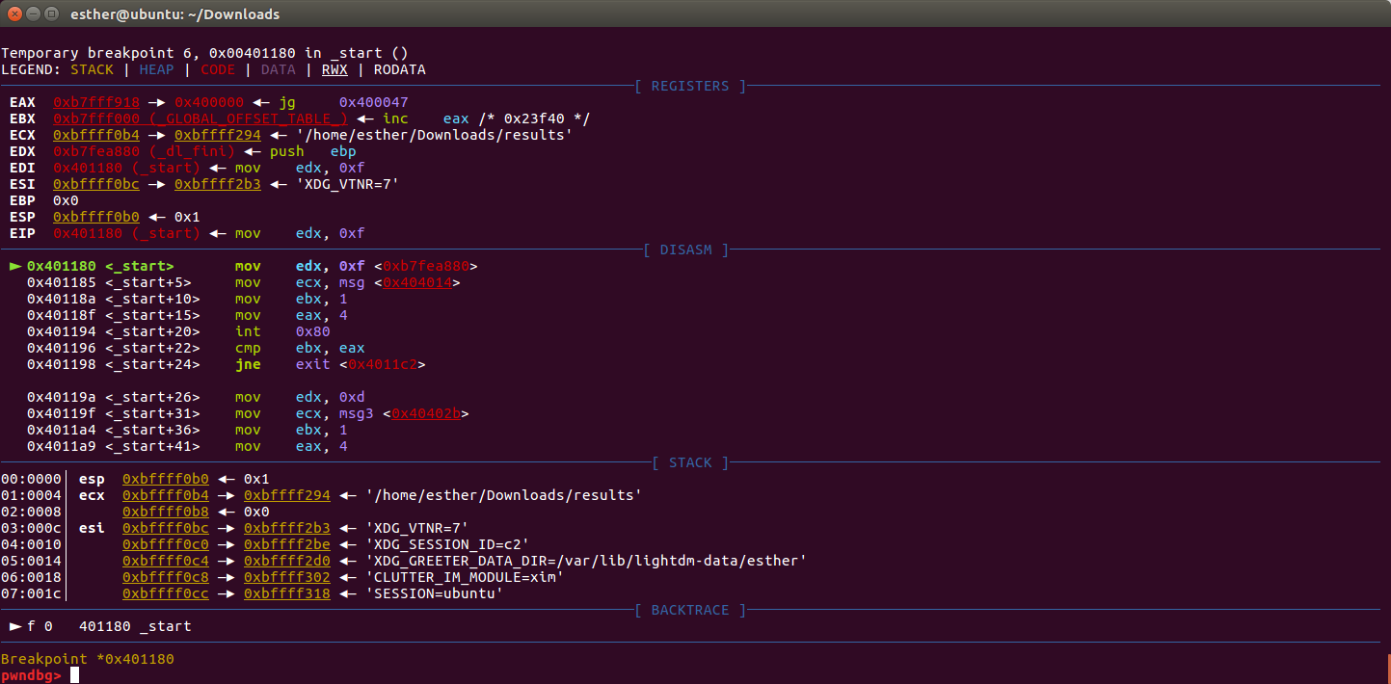

Slide 14
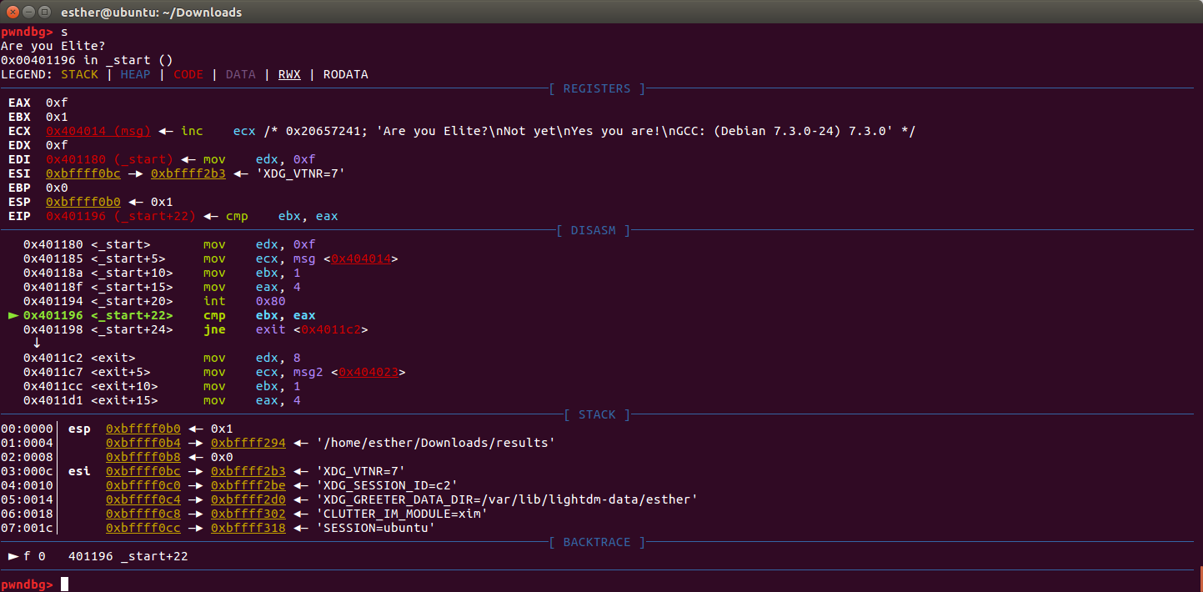
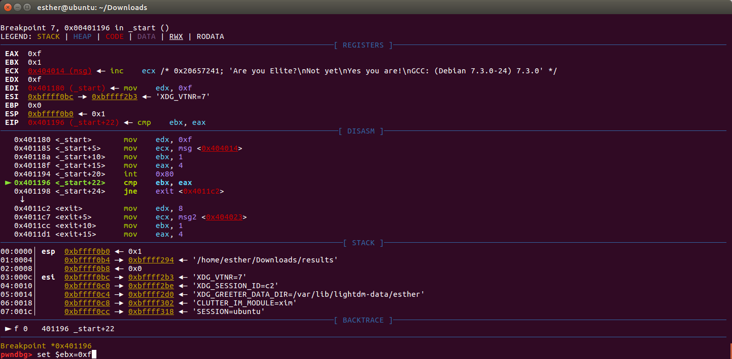
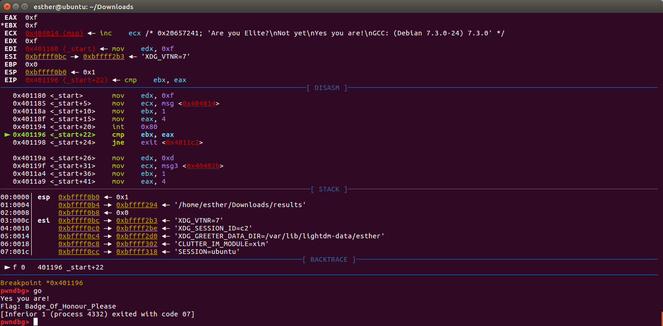

Slide 15
What I learned
That some problems are more easier than you think
Learned new problem solving skills
That I am driven by curiosity and knowledge
I am passionate about cyber security
I can learn rapidly

Slide 16
Bibliography
QR Code Generator - https://www.the-qrcode-generator.com/
Cyber Discovery - https://joincyberdiscovery.com/
Base64 Table - https://en.wikipedia.org/wiki/Base64

